Slide 1
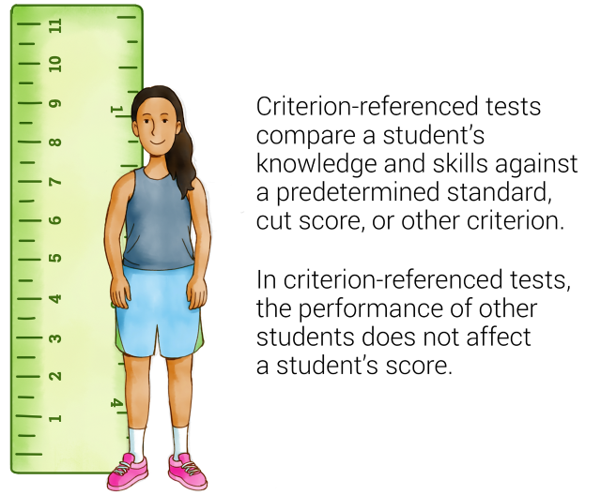
MASTERY CRITERION REFERENCED
Uriel Ortega Vega
Council of Europe. (2001a). The Common European Framework of Reference for Languages.
Recuperado de www.uk.cambridge.org/elt

Slide 2



Example:
Uriel Ortega Vega
Monthly tests
Coursework projects
Classroom Excercises

Slide 3
Continuum Criterion
Referenced
Uriel Ortega Vega
The Continuum criterion-referencing approach is an approach in which an individual ability is referenced to a defined continuum of all possible degrees of ability in the area in question.
Council of Europe. (2001a). The Common European Framework of Reference for Languages.
Recuperado de www.uk.cambridge.org/elt

Slide 4

Example:
Uriel Ortega Vega

Slide 5
References:
Uriel Ortega Vega
Council of Europe. (2001a). The Common European Framework of Reference for Languages.
Recuperado de www.uk.cambridge.org/elt

